Slide 1
Software Deployment in the Field:
Technical Debt and Data-Ops
SEA Software Engineering Conference
April 14, 2015
Gary Granger
Earth Observing Laboratory
NCAR

Slide 2
Stories from the Field (and a big mistake from my past)

Slide 3
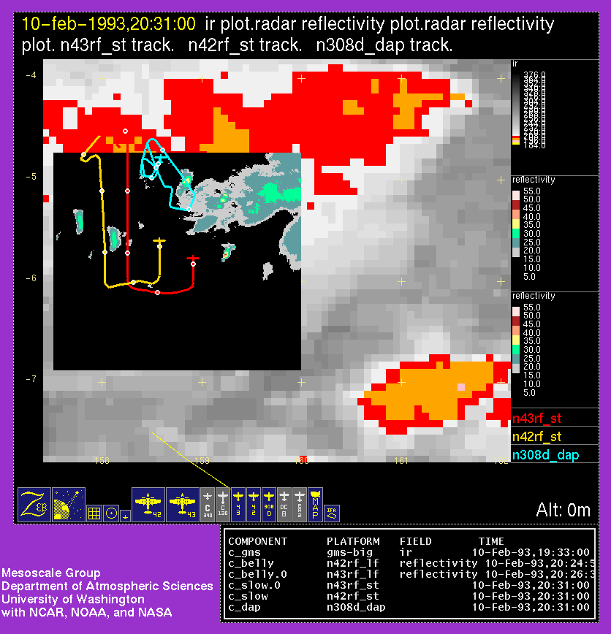

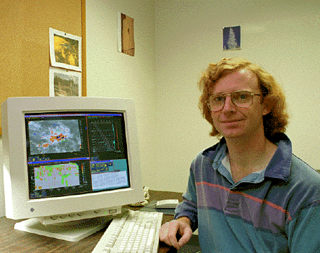
TOGA-COARE in Honiara, Solomon Islands

Slide 4
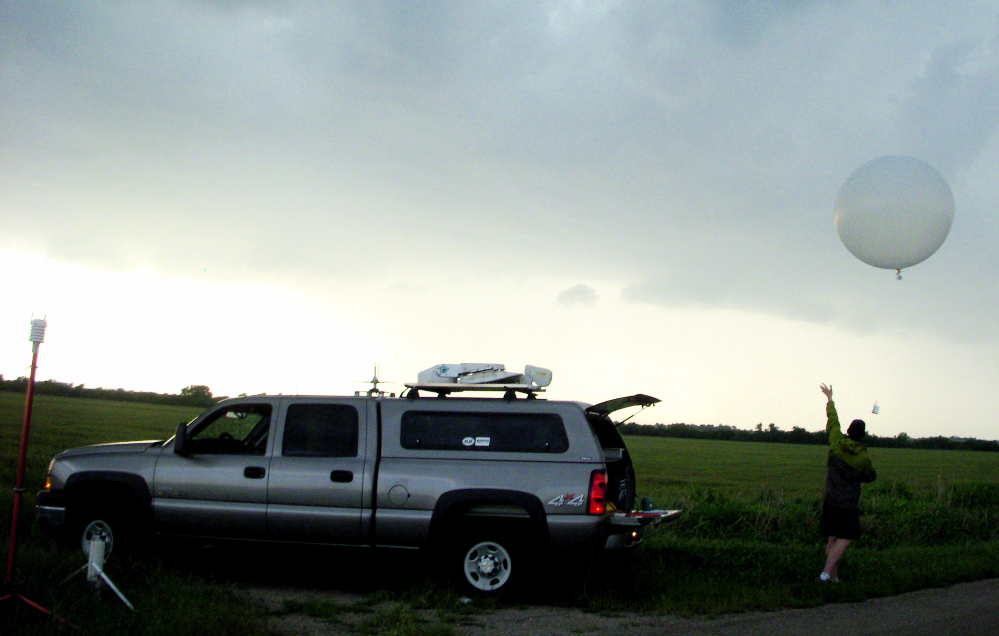
Mobile Sounding Launch at VORTEX-II

Slide 5
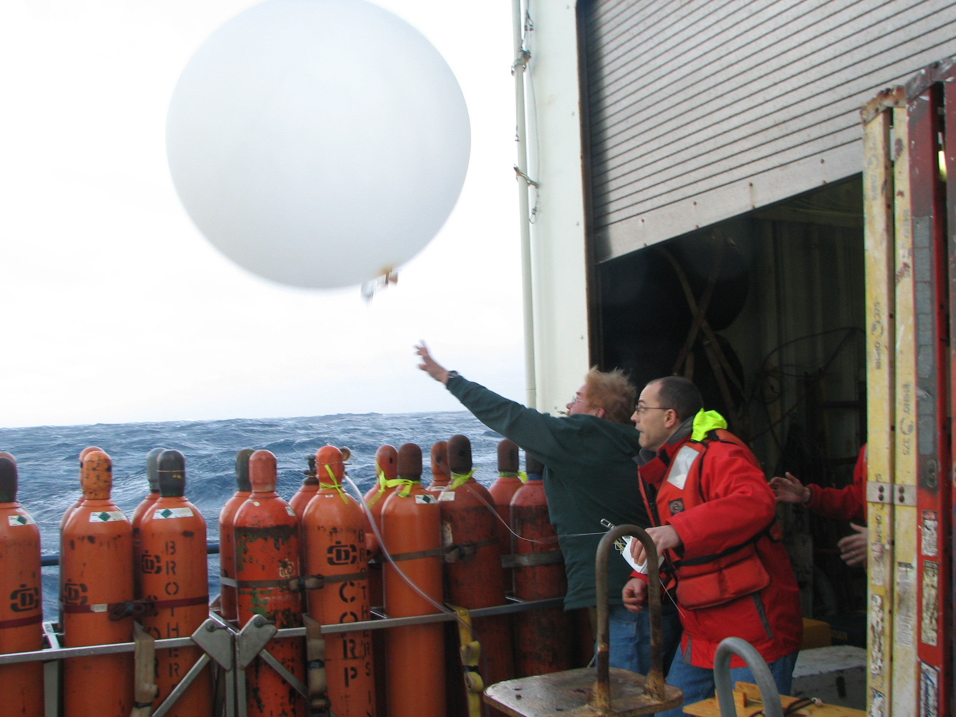

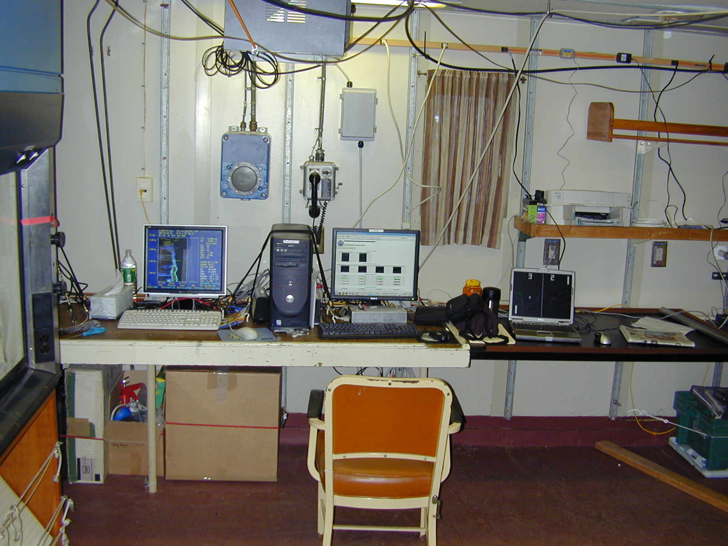
R/V Knorr in CLIMODE

Slide 6
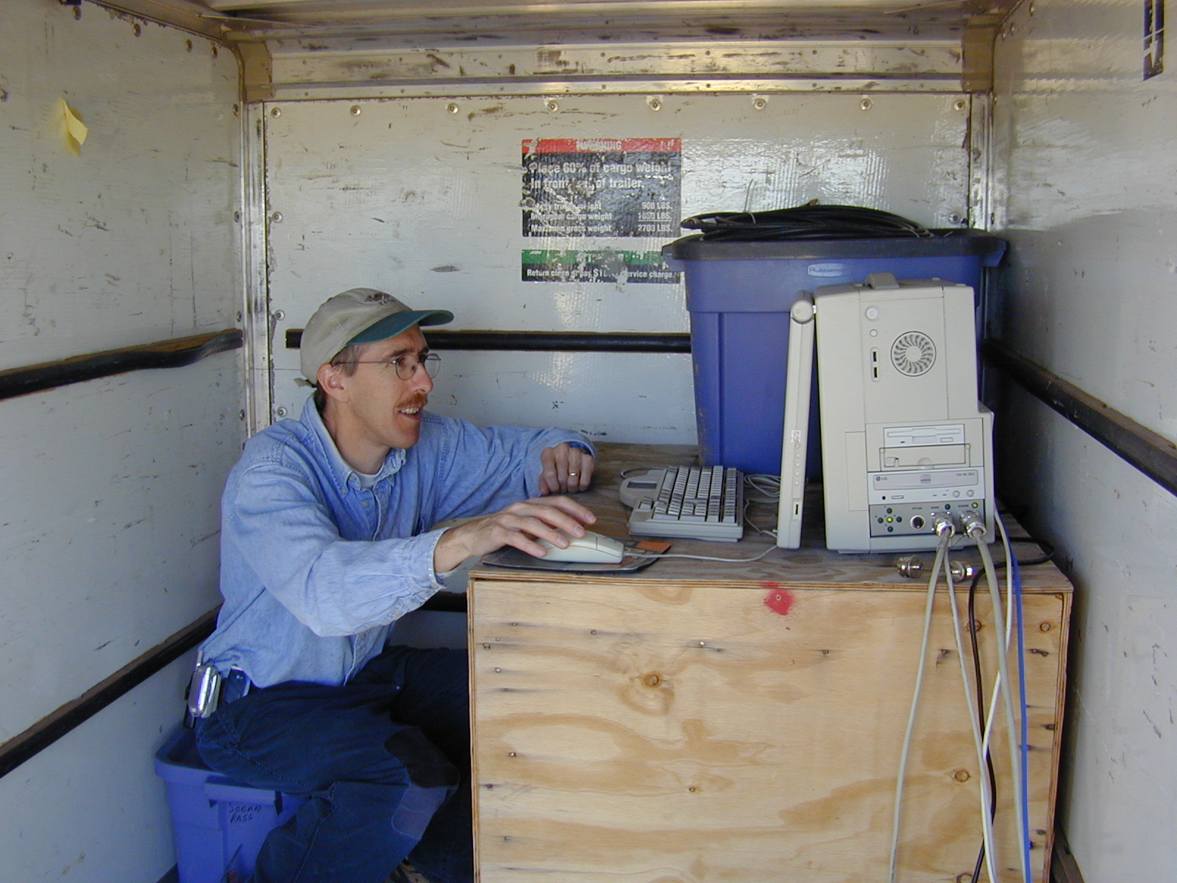
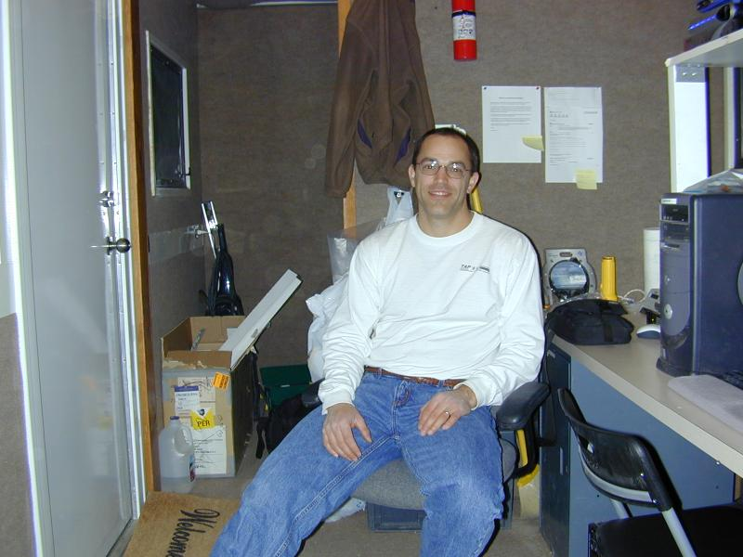
Coding Can Happen Anywhere
Sea Containers
Rental Trailers
Ship Labs

Slide 7
Integrated Sounding System
The ISS is a platform for hosting a collection of boundary-layer instruments which can be configured for each field project site while sharing a common deployment and data management infrastructure, comprised of networking, computer systems, and software.

Slide 8
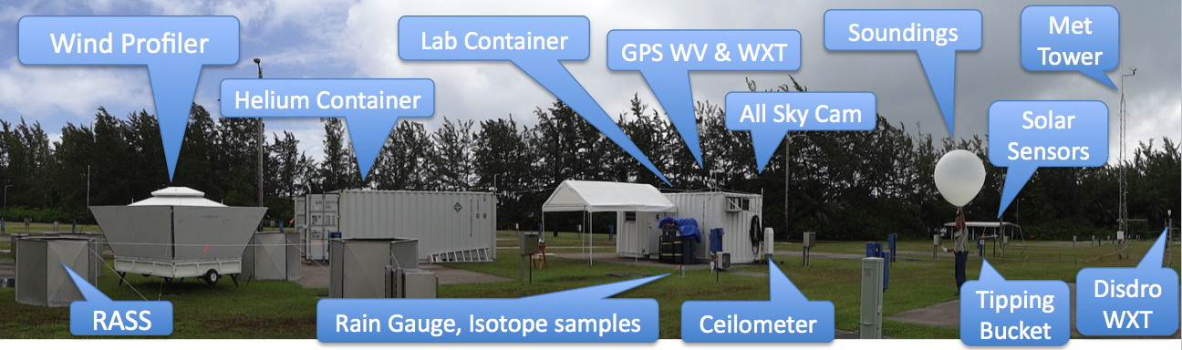
ISS at DYNAMO, Diego Garcia

Slide 9
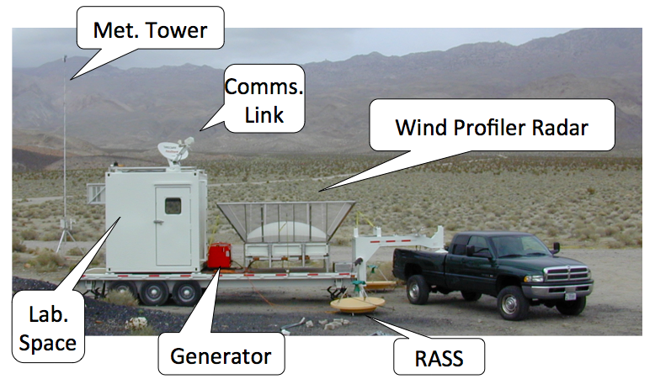
Mobile ISS at T-REX

Slide 10
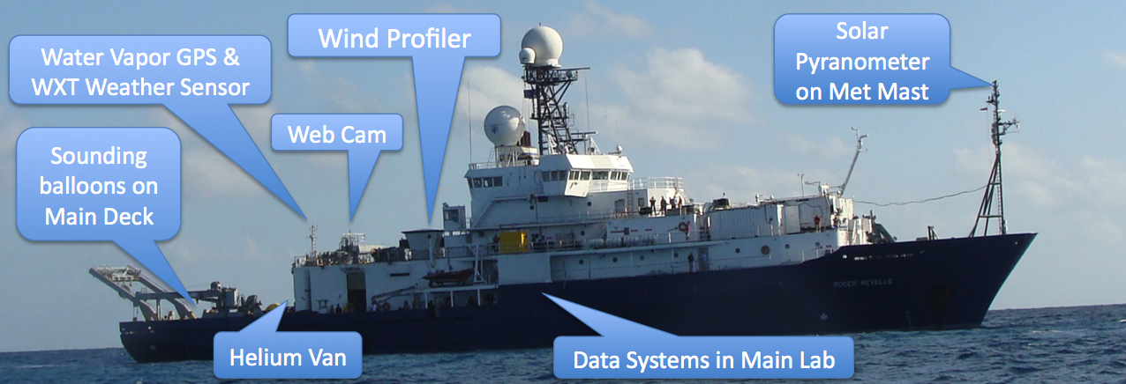
ISS at DYNAMO, R/V Revelle

Slide 11
Technical Debt
Shipping first time code is like going into debt. A little debt speeds development so long as it is paid back promptly with a rewrite. ... The danger occurs when the debt is not repaid.
- Ward Cunningham

Slide 12
Technical Debt
Shipping first time code is like going into debt. A little debt speeds development so long as it is paid back promptly with a rewrite. ... The danger occurs when the debt is not repaid.
- Ward Cunningham
All field project deployments are like shipping first time code.
- Me

Slide 13
Technical Debt
Every minute spent on not-quite-right code counts as interest on that debt. Entire engineering organizations can be brought to a stand-still under the debt load of an unconsolidated implementation, object- oriented or otherwise.
- Ward Cunningham

Slide 14
Technical Debt Pressures in the Field
Mission Creep
Since we're so close already...
Live Testing
Now that we've got everything all together
User Interaction
By the way, now I understand what I really need...
Thrill and Excitement
What's more fun than real-time coding under pressure?

Slide 15
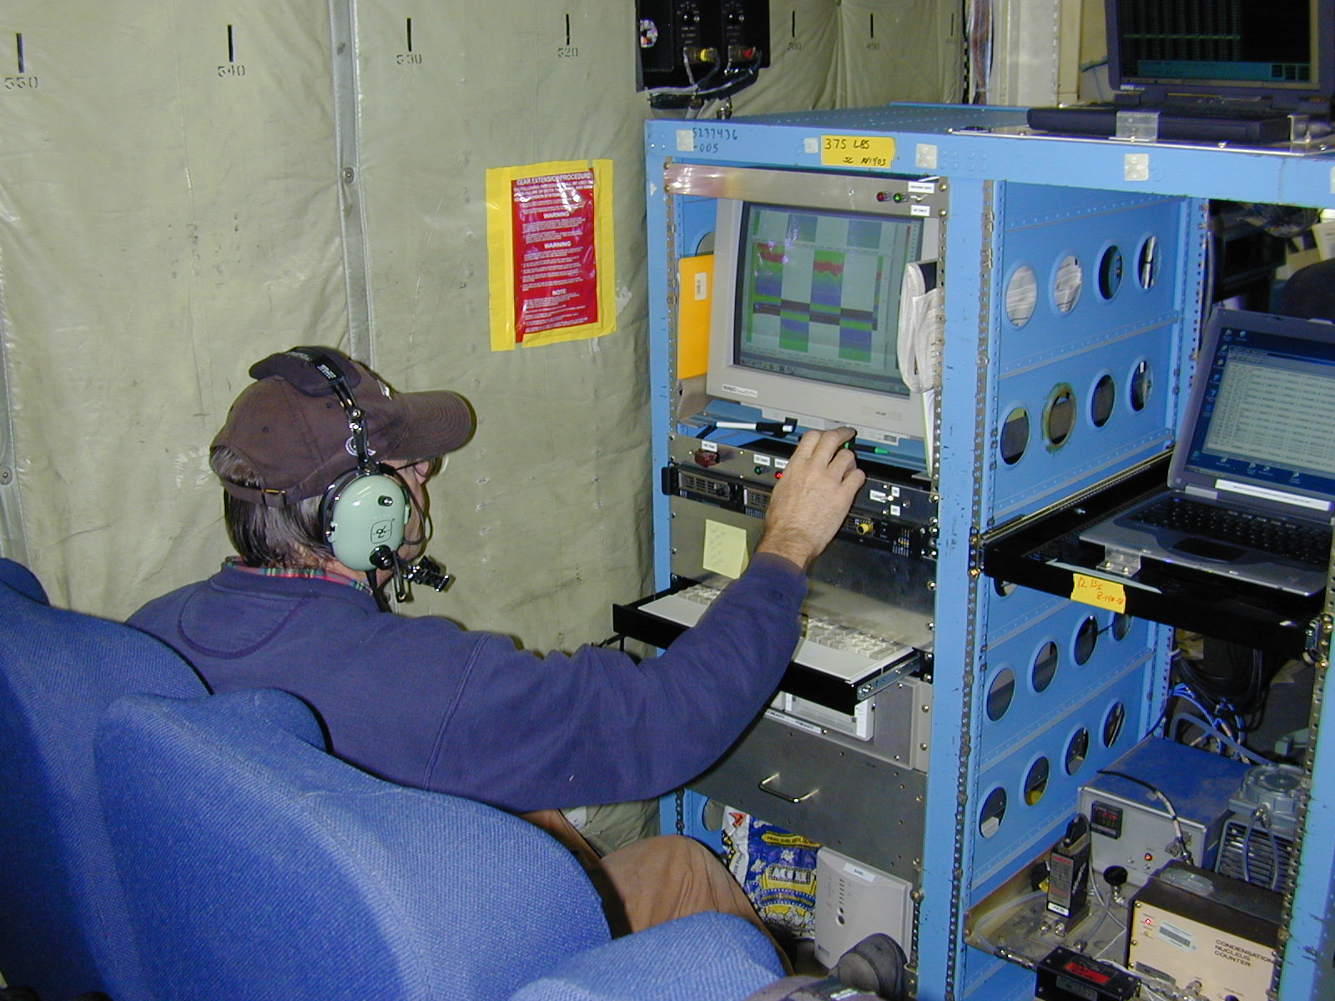
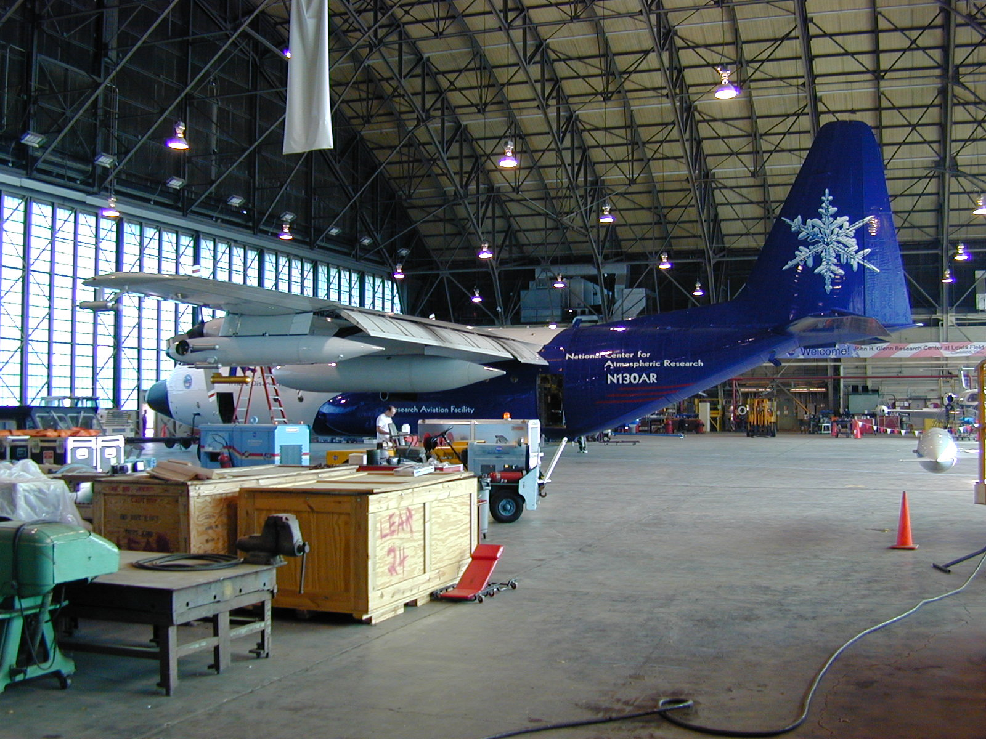
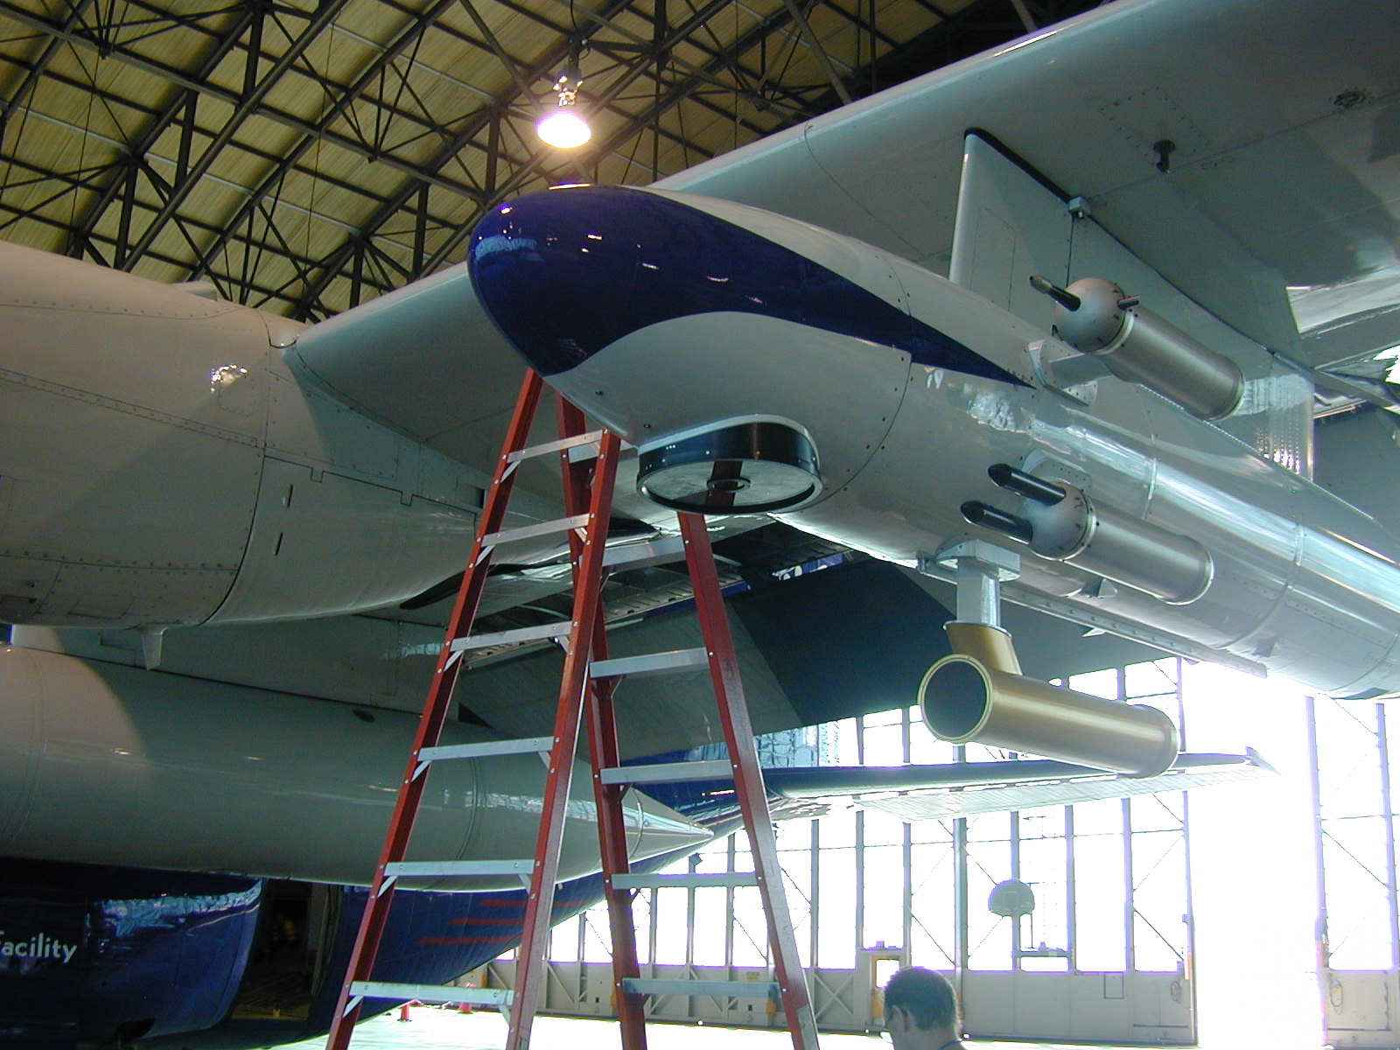
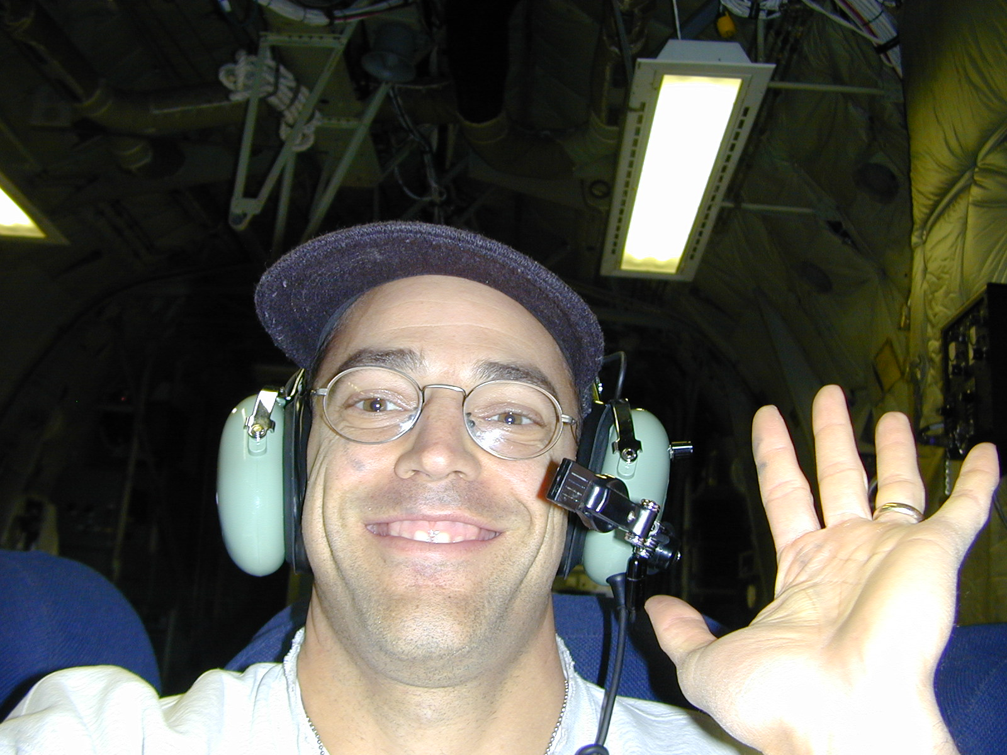
SABL LIDAR on the C-130

Slide 16
Other Technical Debt in the Field
Instrument Data
If you record it, you own it
System Configuration
Once you tweak it, you have to keep tweaking it
Issue Documentation
“Those who forget the past are doomed to repeat it.”
Users never forget a feature
Adding a feature in the field is never a one-time thing
Outside instruments and software
Paying interest on debt someone else accumulated

Slide 17
ISS as a Test Case
(Putting Debt Reduction into Practice)

Slide 18
Reducing Technical Debt in the Field (1)
Design to Deploy
Software is not working until it is deployable
Python classes wrap external, third-party programs
Test Deployments
Deploy tests and run them on targets
Script installation and confirmation of dependencies

Slide 19
Reducing Technical Debt in the Field (2)
Consolidate and deploy the configuration
Single access point
No redundant configuration
Keep it in revision control
Beware overlooked configuration sources like crontabs, BIOS settings, routers, web devices
Use the configuration for devops also

Slide 20
System Configuration
Bare metal installs and restores with kickstart files and bash scripts
Modular bash scripts for configuring every instrument data flow (slowly migrating to python)
JSON configuration file for each site kept in revision control
Scripts can be re-run at any time to update the system as the configuration changes

Slide 21
Reducing Technical Debt in the Field (3)
Automate failure detection
Whatever checks you do manually, script the ones that can be scripted for monitoring tools like Nagios
For ISS, custom python scripts check USB backups, data broadcasts, missing data

Slide 22
Applying Devops to Data: Data-Ops
Treat data streams like devops servers
Easy to deploy from one field project to the next
Easy to add and manage new data streams
Automate deployment of the tools needed to process each data stream
Continuously generate deliverable data products from the raw data streams and a single project configuration
Like continuous integration for software, but for data

Slide 23
Parse, Calibrate
Copy Soundings
Clutter
Removal
Moments
Average
Winds
Winds
NetCDF
EOL
Transfer
NetCDF Hourly
Web Plots
NetCDF
Web Plots
Web Plots

Slide 24

ISS Field Network
EOL
Profiler PC
Data
Manager
LIDAR PC
Surface
Ceilometer PC
Web Cam
SODAR PC
Water Vapor
Disdrometer

Slide 25
ISS Python Catalog
Scan: filename patterns, simple format parsing including netcdf and SPC, read data samples
Catalog: query by name, time, category, size, checksums, and more complicated
Check: gaps, latency, sample density, custom, nagios reports, email alerts
Archive: ISO image with metadata from catalog query, integrity checks, transfers to EOL
Derive: Run processing when inputs have changed

Slide 26
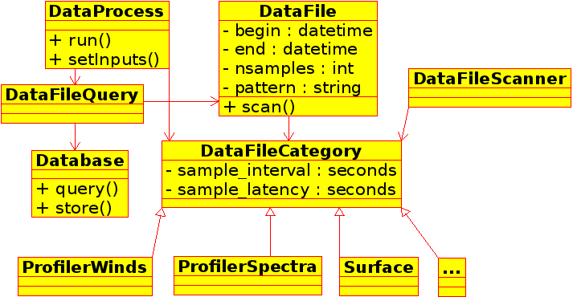
ISS_Catalog Class Diagram

Slide 27
Python Helps
Parsing of custom data files, text and binary
Scipy.io.netcdf and numpy
Built-in sqlite
Built-in JSON
py.test and pylint
Potential evolution into a web app

Slide 28
Dev and Data Ops
Goals for ISS:
Configure an entire project deployment, all of its sites, instruments, data streams, derivations, and monitoring, with just the JSON parameter database and a python customization script.
Implement the real-time and post-project data processing like a continuously running build process, where all derived data products are regenerated and updated as the raw data files are filled in or as project parameters change.

Slide 29
Conclusion
Technical debt is a useful metaphor for software engineers and maybe even managers.
Consolidate and deploy the project configuration.
Automate field deployments using devops and based on the project configuration.
Automate data processing with parameters from the project configuration.
Integrate and automate with python. (rsync is awesome too.)

